Slide 1
github
git

Slide 2


Slide 3
Git tutorial
https://product.hubspot.com/blog/git-and-github-tutorial-for-beginners
Complete the above / watch a YouTube video / find an interesting tutorial online
We will mostly be doing branches
Pull requests (etc) will be used in group projects (at a later date)
Source control is vital to all software development projects.
You will need to know this for any software / project management job role.

Slide 4
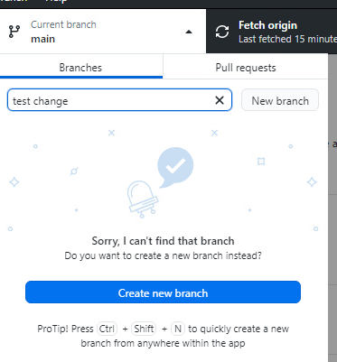
Task
Go back to lecture 12 – css classes
Create a branch
Change some code
Commit and merge
Document your progress – you will need to refer back to this document for future reference

Slide 5
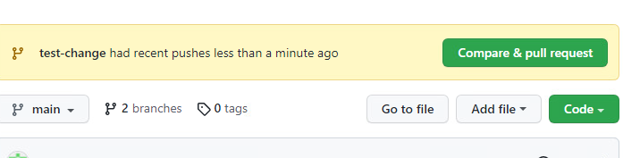
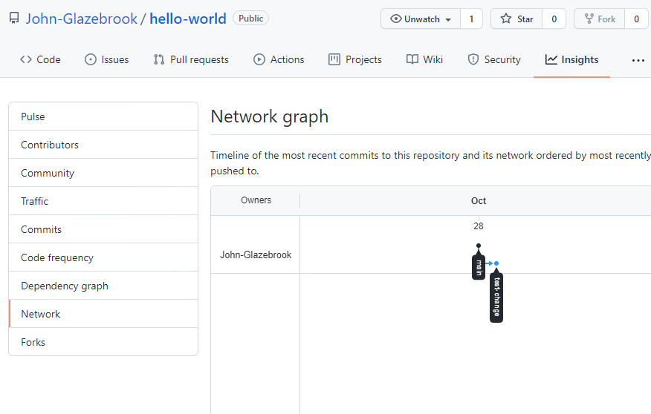
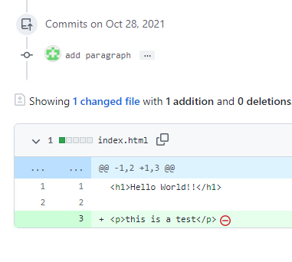
See your branch.
Ensure you can switch from the test branch back to main

Slide 6
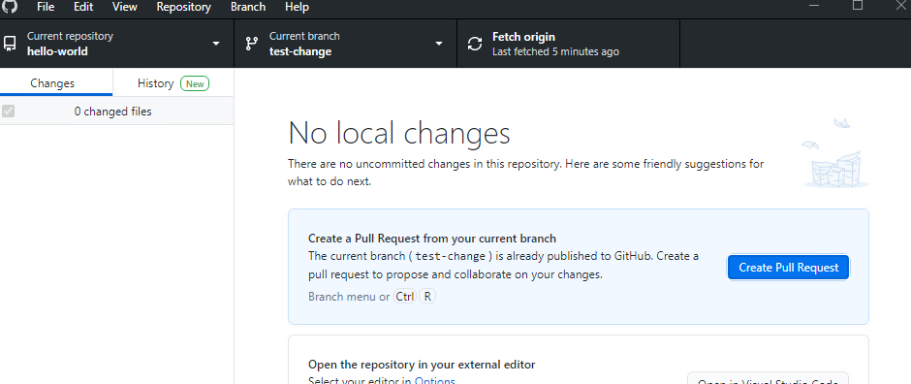
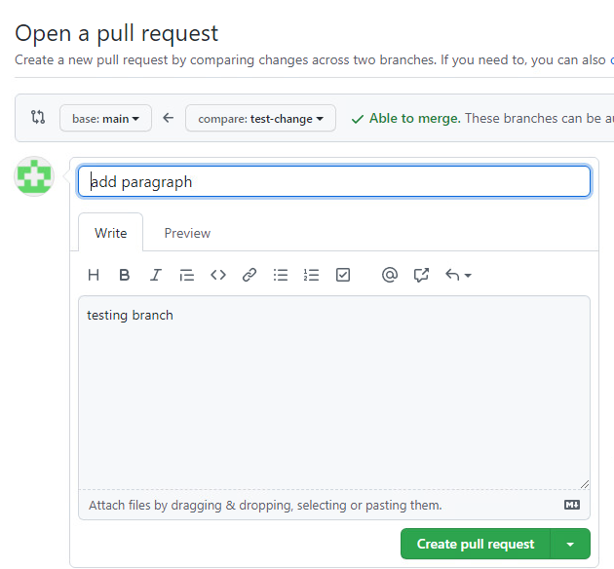
Create a pull request

Slide 7
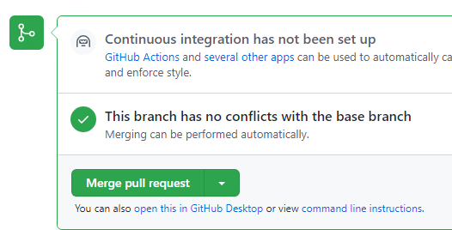
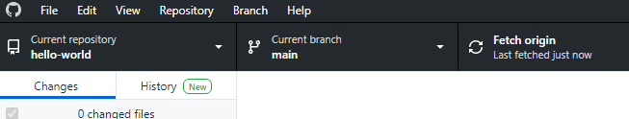
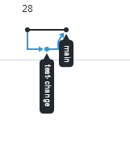
In github desktop change to main branch then pull do a refresh (Fetch Origin)
Pull down changes (I forgot to screenshot this step ☹ )
Check your merge is in main
Check the network diagram to see the merge
All work should now be done in a branch and merged when tested

Slide 8
Complete your document
Complete the document
Put lots of notes in
Add a second branch
Make changes
Merge
Ensure you are comfortable with the process
Ask another student to see their branch / pull request / merge

